Slide 1
Decorator design pattern

Slide 2

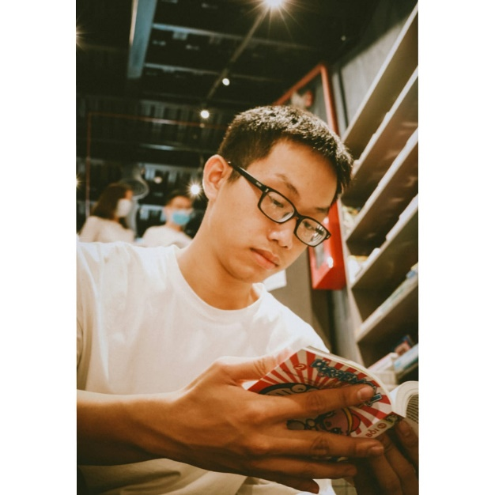
Our team
Nguyễn Hoàng Khôi
Vương Quốc Ấn
10421030
10421002

Slide 3
Table of contents
01
02
03
04
Overview
Definition
Benefit
Demonstration

Slide 4
01
Overview

Slide 5
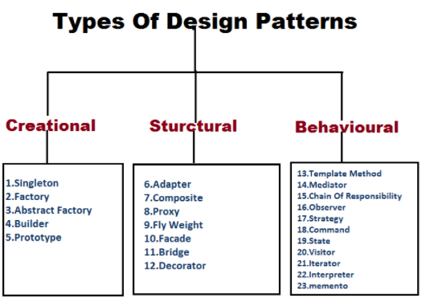
- Design pattern are categorized into 3 main groups
- Decorator pattern is a Structural pattern

Slide 6


Idea: - The Open-Closed Principle
Feel free to extend our classes with any behavior
Spent a lot of time getting this code correct and bug free => cannot let you alter the existing code

Slide 7
02
Definition

Slide 8
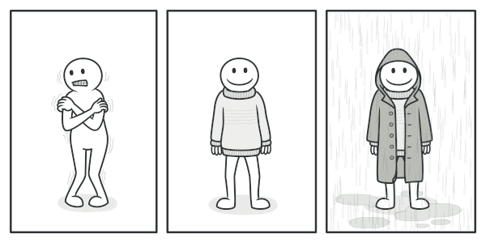

Slide 9
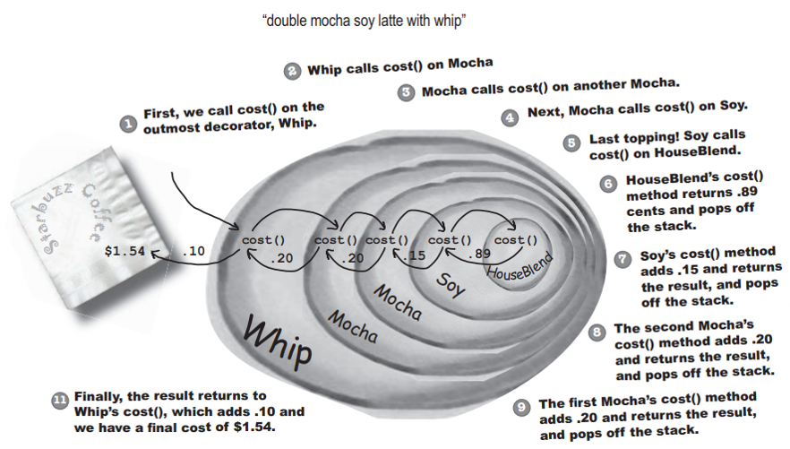
Using Decorator Patten

Slide 10
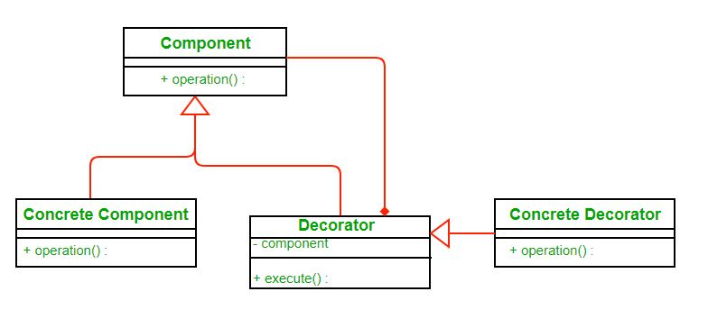
Class Diagram

Slide 11
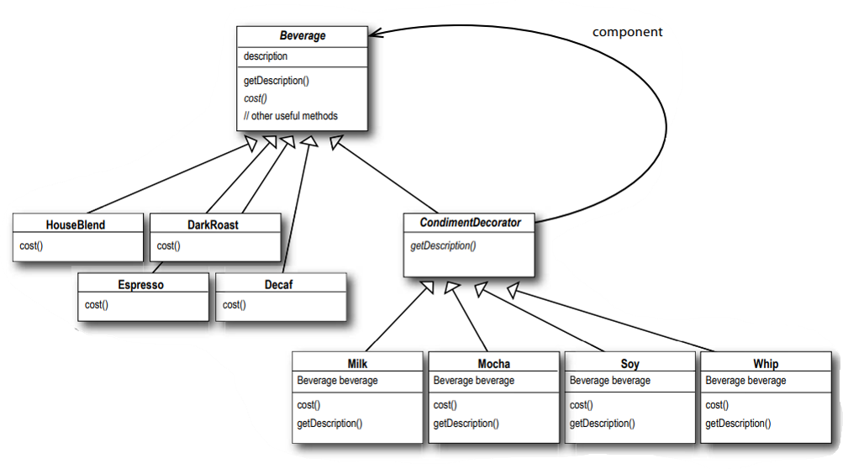
Class Diagram

Slide 12
03
Benefit

Slide 13
Benefits
01.
02.
03.
Extensions of functionality without modifying the original object
Flexibility: Allow to add and remove functionalities dynamically at runtime
The decorations are independent of each other

Slide 14
04
Demo
Designing the Starbuzz Coffee

Slide 15
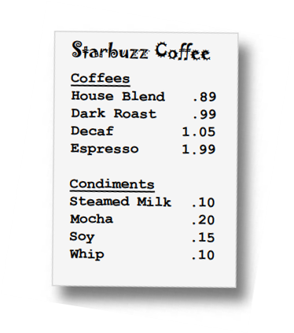
Problem

Slide 16
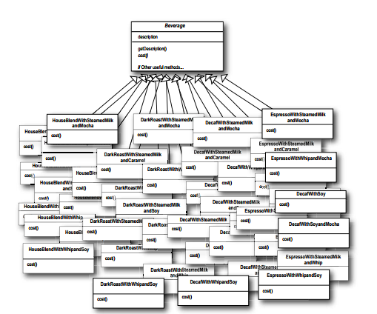
Initial thoughts

Slide 17
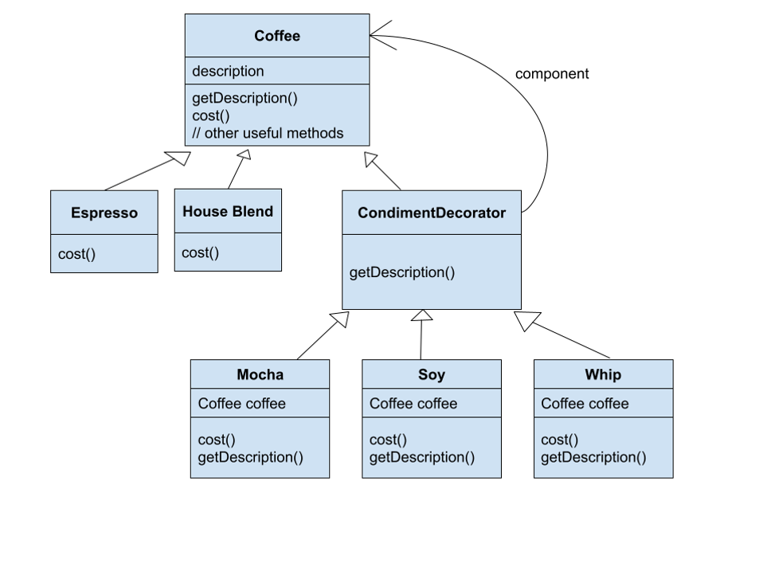
Class Diagram

Slide 18
Thank You

